Slide 1
Executive Function
Jennifer Petrich, PhD

Slide 2
Outline
Review of executive functions (EF) and neurobiology of impaired EF
How impaired EF manifests in dyslexic students
How to address these deficits when working to remediate spelling and math in a dyslexic student

Slide 3
What is Executive Function?
A set of cognitive abilities that control and regulate other abilities and behaviors.
Executive functions include the ability to:
  initiate behaviors (task initiation)
  delay or prevent inappropriate responses (inhibition)
  monitor, change or stop behaviors (regulation)
  manage interference (cognitive flexibility)
  plan future behavior when faced with novel tasks and situation (reconstitution)
These skills occur on a continuum.

Slide 4
Functional Categorization
  Cognitive Skills
  Working Memory
  Planning/Prioritization
  Organization
  Time Management
  Metacognition
  Behavioral Skills
  Response Inhibition
  Emotional Control
  Sustained Attention
  Task Initiation
  Goal-directed Persistence
  Flexibility

Slide 5
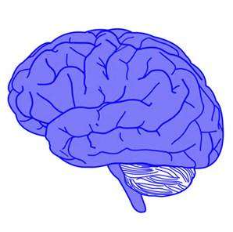
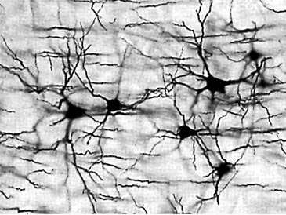
Learning
Learning by experience
  Use it or Lose it
Neural networks
Multi-sensory instruction
  Sensory
  Motor
  Auditory
  Visual

Slide 6
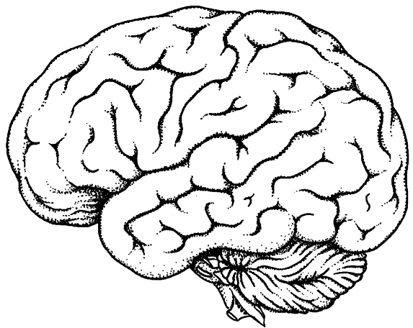
Brain Areas
mot
Motor Planning
Motor
Sensory
Integration Areas
EF skills
Visual
Auditory

Slide 7
Foundational Functions
Inhibition
Working Memory
Shifting/
Cognitive Flexibility

Slide 8
Barkley’s Hybrid Model
Behavioral Inhibition
Self-regulation of affect/motivation/arousal
Working Memory
Internalization of speech
Reconstitution
Motor control/fluency/syntax
Notes:
Delay or prevent inappropriate response; stop ongoing unsuccessful response (perseveration); manage interference (distractions or interruptions )

Slide 9
General Accommodations
Step-by-step instructions
Written directions with oral instructions whenever possible
Use visual organizational aids, visual schedules, and alarms
Plan and structure transition times and shifts in activities.

Slide 10
Executive Function
and Dyslexia

Slide 11
Internal Language
Also called “self-talk”, “internal speech”, etc.
Impaired in students with poor phonological processing/working memory
Deficit results in “islands of knowledge”
Required for:
  following multi-step directions (recipe)
  learning new motor tasks (tying a shoe, swimming)
  copying visuo-motor input (letters; sign language)
  establishing neural networks of activation (domino effect, e.g. NYC, right triangle)

Slide 12
Creating Internal Language
Increase phonological working memory
Practice verbalizing externally
Move from external to internal language using six steps:
  I say, I do (modeling)
  We say, we do
  I say, you do (with verbalizing; say before doing)
  You say, I do (follow instructions exactly)
  You say, you do (external)
  You say, you do (internal)

Slide 13
Using Internal Language
Practice with physical tasks (e.g. shoe tying)
Practice imagery tasks (getting ready in the a.m.)
Drawing on paper
Use with other modalities to store information (language, pictures, gestures, concepts)
Problem-solving
Encoding new information

Slide 14
Applying Internal Language: Spelling

Slide 15
Applying Internal Language: Spelling
Overview
  History of spoken English
  Writing systems are based on meaning not speech
  Homophone Principle
  Elements and Suffixing Conventions
  Scientific Investigation (SWI process)

Slide 16
Scientific Inquiry
Written Language
  Investigate semantics (meaning)
  Hypothesize about morphology (form/structure)
  Test your hypothesis using etymology (history and relatives)
  Investigate orthographic phonology
  Revise your hypothesis as needed

Slide 17
Scientific Inquiry
Four questions
  What does it mean?
  How is it built?
  What are its relatives?
  What segments of pronunciation are important for meaning?
Model
  Verbalize thought process/questions
  Use signs/gestures
Abstract out of the process (use visual cues if necessary)

Slide 18
Scientific Inquiry
The four questions
  Q1: What does it mean?
  Q2/3: How is it built? What are its history and relatives?
  Q4: What can we learn from its pronunciation?
Notes:
Different kinds of reading, use of nonsense words and spelling words from pronunciation; a question is a quest

Slide 19
Scientific Inquiry
<sign>
Q1: What does it mean?
noun
1 an object, quality, or event whose presence or occurrence indicates the probable presence or occurrence of something else
2 a gesture or action used to convey information or instructions
4 Mathematics the positiveness or negativeness of a quantity
verb
1 [with object] write one's name on (a letter, card, or similar item) to identify oneself as the writer or sender
2 [no object] use gestures to convey information or instructions

Slide 20
Scientific Inquiry
<sign>
Q2: How is it built?
<sign> is a base element

Slide 21
Scientific Inquiry
<sign>
Q3: What are its history and relatives?
  sign (n.)
  early 13c., "gesture or motion of the hand," especially one meant to communicate something, from Old French signe "sign, mark," from Latin signum "identifying mark, token, indication, symbol; proof; military standard, ensign; a signal, an omen; sign in the heavens, constellation," according to Watkins, literally "standard that one follows," from PIE *sekw-no-, from root *sekw- (1) "to follow."

Slide 22
Scientific Inquiry
<sign>
Q3: What are its history and relatives?
  sign (v.)
  c. 1300, "to make the sign of the cross," from Old French signier "to make a sign (to someone); to mark," from Latin signare "to set a mark upon, mark out, designate; mark with a stamp; distinguish, adorn;" figuratively "to point out, signify, indicate," from signum "identifying mark, sign" (see sign (n.)). Sense of "to mark, stamp" is attested from mid-14c.; that of "to affix one's name" is from late 15c. Meaning "to communicate by hand signs" is recorded from 1700. Related: Signed; signing.

Slide 23
Scientific Inquiry
<sign>
Q3: What are its history and relatives?
      signs → sign + s
      signed → sign + ed
      signing → sign + ing
      signal → sign + al
      signify → sign + i + fy
      design → de + sign
      designate → de + sign + ate
      signature → sign + ate + ure
      resignation → re + sign + ate + ion

Slide 24
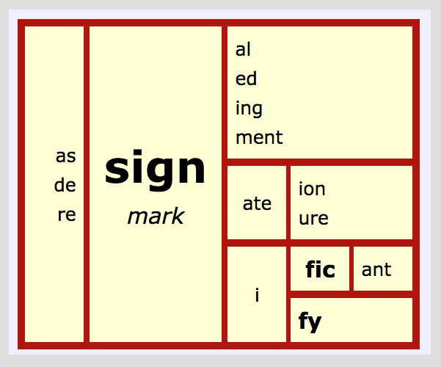
Scientific Inquiry

Slide 25
Scientific Inquiry
<sign>
Q4: What can we learn from its pronunciation?
    <s i g n> <d e s i g n>
    [s ɑɪ n] [d ə z ɑɪ n]
    <s i g n a l>
    [s ɪ g n ə l]
    <r e s i g n a t i o n>
    [r ɛ z ə g n ɛi ʃ ə n]

Slide 26
Scientific Inquiry
Other spellings to ponder
  Why is there a <w> in <two>?
  Why do we spell [dɪfrənt] <different> and not <difrent>
  Why do we not replace the <e> at the end of <change> in <changeable>?
Notes:
Is the <w> an etymological marker or zero allophone?

Slide 27
Applying Internal Language: Math

Slide 28
Applying Internal Language: Math
Overview
  Number Sense
  Operations/Math Facts
  Word Problems
  Fractions, Decimals, Percents
  Algebra

Slide 29
Applying Internal Language: Math
Number Sense
  Concrete to imagery (manipulatives, number line, ASL numbers)
  Investigate and Verbalize (number, count, cardinal, ordinal, magnitude)
Operations/Math Facts
  Concrete to Imagery (manipulatives, symbols, signs/gestures)
  Investigate and Verbalize (addition, subtraction, multiplication, division)
  Use what you know to figure out what you don’t know

Slide 30
Applying Internal Language: Math
Word Problems
  Concrete to imagery (manipulatives, signs)
  What do we know, what do we want to know, how do we figure it out?
Fractions, Decimals, Percents
  Concrete to Imagery (manipulatives, symbols, signs/gestures)
  Investigate and Verbalize (fractions, decimals, percents)

Slide 31
Applying Internal Language: Math
Algebra
  Conceptual understanding
  Investigate and Verbalize
    Evaluate the expression
    Isolate the variable
    Solve the equation
    Plot the ordered pair
    Linear

Slide 32
Math Example: Subtraction
Conceptual: Whole vs. Parts
  Start with the whole
  Take away the part (encode with sign/gesture)
  Result = part taken away, amount that is left
Investigate: subtraction → sub + tract + ion
  trahere = to pull, draw
  subtract = to take away, draw from below
draw pictures, use gestures
verbalize steps
solve example problem

Slide 33
Summary
EF: input → inhibition → processing → output
Break down larger concepts and model language and thought process/language
Importance of verbalization/internal language
Use resources and multiple modalities to anchor language and concepts
Practice, practice, practice!

Slide 34
Resources
Smart But Scattered
Peg Dawson, EdD, and Richard Guare, PhD
Executive Skills in Children and Adolescents
Peg Dawson, EdD, and Richard Guare, PhD
Promoting Executive Function in the Classroom
Lynn Meltzer

Slide 35
Resources: Investigation of Written Language
Gina Cooke (LEX): https://linguisteducatorexchange.com/lexinars/
Pete Bowers (WordWorksKingston): http://www.wordworkskingston.com/WordWorks/Home.html
Real Spelling: http://www.realspelling.fr/

